Slide 1
Variations of ML Problems
Supervised learning: training data is labeled
Unsupervised learning: no labels available
Semi-supervised learning: some training data is labeled
Reinforcement learning: the system interacts with an environment, which provides reward or punishment used for modifying model parameters

Slide 2
Unsupervised Learning
10-4-2023

Slide 3
Unsupervised Learning
Data are not labeled, or the labels are unimportant.
Examples:
Bones found at an archaelogy dig
Fingerprints of unknown people
Behaviors of people in a public place
“Market basket”: what items were purchased together in a store
Even when labels are provided, unsupervised learning can first be performed, facilitating the final steps of supervised ML.

Slide 4
Three Variations
Grouping given data (e.g., deciding which student records resemble each other more than others)
Dividing space into regions (e.g., deciding into which pile a newly dug-up bone should be placed)
Mapping data points to a small subset of vectors (e.g., interpreting noisy/corrupted signals received over a communication channel)

Slide 5
Models used in Unsupervised Learning
A suitable subset of given data
A set of points in the data space that may not be the same as any of the given data
“Prototypes” (similar to the above, possibly in a non-numerical data space)
Neural network models in which weight vectors resemble points in data space.
Descriptions of subsets of data space using equations (e.g., a bunch of plane segments bounding a region in 3D space)
Binary-valued features that distinguish some subsets of data.

Slide 6
Clustering: the most frequently used unsupervised learning approach
A cluster is a subset of available data.
Clustering is the process of splitting data into subsets, usually non-overlapping.
Clustering algorithms vary depending on the type of problem addressed, the overall objective and the similarity or distance measure.
We often assume that all other data preprocessing steps have already occurred, e.g., feature extraction.

Slide 7
The following slides on clustering are borrowed from Prof. Carla Brodley, which are based on slides of Prof. Eamonn Keough

Slide 8
Clustering
Goal: Split up data into non-overlapping subsets, such that each subset contains similar data.
Example Applications:
Identify similar energy use customer profiles, each of which is a time series of energy usage
Identify anomalies in user behavior for computer security, where the data consists of sequences of user commands
n
Notes:
When we don’t have labels (I.e., f) we have an unsupervised learning problem.
We can apply clustering to
Find the prototypes in our data – for example to find similar customers
Find the large groups of similar observations to identify deviations/anomalies/outliers.

Slide 9

Magellan Image of Venus

Slide 10
Prototype Volcanoes

Slide 11
Why cluster?
Labeling is expensive
Gain insight into the structure of the data
Find prototypes in the data
Notes:
Until now we have assumed that the training data is labeled.
Now we look at what can we do with data when we have not labels.
\item Example: group customer behavior, find similar buying patterns.

Slide 12
Goal of Clustering
Given a set of data points, each described by a set of attributes, find clusters such that:
Inter-cluster similarity is
maximized
Intra-cluster similarity is
minimized
Requires the definition of a similarity measure
F1
x
x
x
x
x
x
x
x
xx
x
x
x
x
x
x
xx
x
F2
Notes:
Data

Slide 13
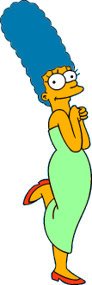




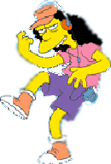



What is a natural grouping of these objects?
Slide from Eamonn Keogh

Slide 14



What is a natural grouping of these objects?
Slide from Eamonn Keogh
Clustering is subjective
Simpson's Family
School Employees
Females
Males

Slide 15
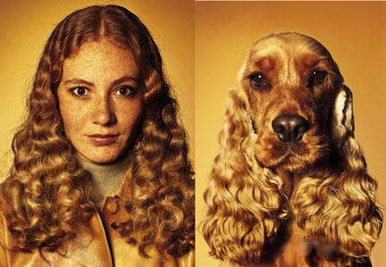
What is Similarity?
Slide based on one by Eamonn Keogh
Similarity is hard to define, but…
“We know it when we see it”

Slide 16
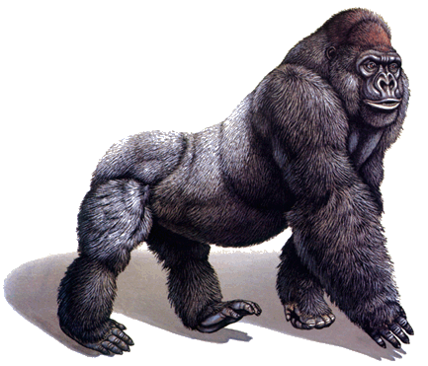
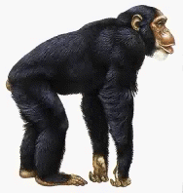
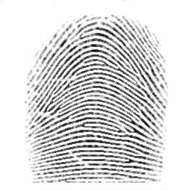
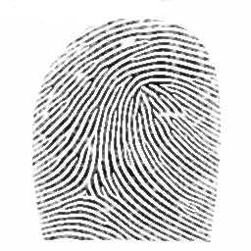
Defining Distance Measures
Slide from Eamonn Keogh
Definition: Let O₁ and O₂ be two objects from the universe of possible objects. The distance (dissimilarity) between O₁ and O₂ is a real number denoted by D(O₁,O₂)
Peter
Piotr
0.23
3
342.7

Slide 17
Slide based on one by Eamonn Keogh
What properties should a distance measure have?
D(A,B) = D(B,A) Symmetry
D(A,A) = 0 Constancy of Self-Similarity
D(A,B) = 0 iif A= B Positivity (Separation)
D(A,B) ≤ D(A,C) + D(B,C) Triangular Inequality

Slide 18
Slide based on one by Eamonn Keogh
Intuitions behind desirable distance measure properties
D(A,B) = D(B,A)
Otherwise you could claim “Alex looks like Bob, but Bob looks nothing like Alex.”
D(A,A) = 0
Otherwise you could claim “Alex looks more like Bob, than Bob does.”

Slide 19
Slide based on one by Eamonn Keogh
Intuitions behind desirable distance measure properties (continued)
D(A,B) = 0 If A=B
Otherwise there are objects in your world that are different, but you cannot tell apart.
D(A,B) ≤ D(A,C) + D(B,C)
Otherwise you could claim “Alex is very like Bob, and Alex is very like Carl, but Bob is very unlike Carl.”

Slide 20


Two Types of Clustering
Slide based on one by Eamonn Keogh
Partitional algorithms: Construct various partitions and then evaluate them by some criterion
Hierarchical algorithms: Create a hierarchical decomposition of the set of objects using some criterion
Hierarchical
Partitional
Notes:
Have class break into groups and invent clustering algorithms.

Slide 21
Dendogram: A Useful Tool for Summarizing Similarity Measurements
Slide based on one by Eamonn Keogh
The similarity between two objects in a dendrogram is represented as the height of the lowest internal node they share.

Slide 22
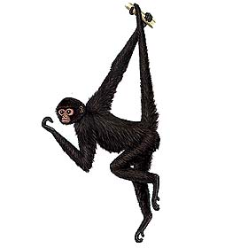
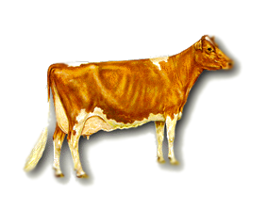
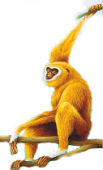
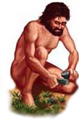
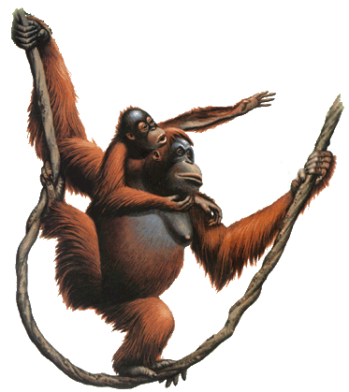
Slide based on one by Eamonn Keogh
There is only one dataset that can be perfectly clustered using a hierarchy…
(Bovine:0.69395, (Spider Monkey 0.390, (Gibbon:0.36079,(Orang:0.33636,(Gorilla:0.17147,(Chimp:0.19268, Human:0.11927):0.08386):0.06124):0.15057):0.54939);

Slide 23
A demonstration of hierarchical clustering using string edit distance
Slide based on one by Eamonn Keogh
Piotr
Pedro
Piero
Peter
Peka
Mick
Pyotr
Pietro
Pierre
Peder
Petros
Peadar
Miguel
Krystof
Michael
Michalis
Crisdean
Cristovao
Christoph
Cristobal
Kristoffer
Christophe
Cristoforo
Christopher

Slide 24











Slide based on one by Eamonn Keogh
Hierarchal clustering can sometimes show patterns that are meaningless or spurious
The tight grouping of Australia, Anguilla, St. Helena etc is meaningful; all these countries are former UK colonies
However the tight grouping of Niger and India is completely spurious; there is no connection between the two.
South Georgia &
South Sandwich
Islands
Serbia &
Montenegro
(Yugoslavia)
AUSTRALIA
St. Helena &
Dependencies
ANGUILLA
U.K.
FRANCE
NIGER
INDIA
IRELAND
BRAZIL

Slide 25
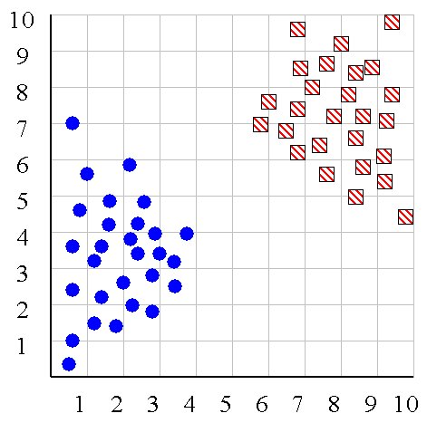
Slide based on one by Eamonn Keogh
We can look at the dendrogram to determine the “correct” number of clusters.
Notes:
In this case, the two highly separated subtrees are highly suggestive of two clusters. (Things are rarely this clear cut, unfortunately)

Slide 26
Slide based on one by Eamonn Keogh
One potential use of a dendrogram: detecting outliers
The single isolated branch is suggestive of a data point that is very different to all others
Outlier

Slide 27
Hierarchical Clustering
Slide based on one by Eamonn Keogh
The number of dendrograms with n leafs = (2n -3)!/[(2^{(n -2)}) (n -2)!]
Number Number of Possible
of Leafs Dendrograms
2 1
3 3
4 15
5 105
... …
34,459,425
Since we cannot test all possible trees we will have to heuristic search of all possible trees. We could do this..
Bottom-Up (agglomerative): Starting with each item in its own cluster, find the best pair to merge into a new cluster. Repeat until all clusters are fused together.
Top-Down (divisive): Starting with all the data in a single cluster, consider every possible way to divide the cluster into two. Choose the best division and recursively operate on both sides.

Slide 28


Slide based on one by Eamonn Keogh
We begin with a distance matrix which contains the distances between every pair of objects in our database.
0
8
8
7
7
0
2
4
4
D( , ) = 8
D( , ) = 1
0
3
3
0
1
0

Slide 29
Bottom-Up (agglomerative): Starting with each item in its own cluster, find the best pair to merge into a new cluster. Repeat until all clusters are fused together.
This slide and next 4 based on slides by Eamonn Keogh
Consider all possible merges…
Choose the best
…

Slide 30
Bottom-Up (agglomerative): Starting with each item in its own cluster, find the best pair to merge into a new cluster. Repeat until all clusters are fused together.
Consider all possible merges…
Choose the best
…
Consider all possible merges…
Choose the best
…

Slide 31
Bottom-Up (agglomerative): Starting with each item in its own cluster, find the best pair to merge into a new cluster. Repeat until all clusters are fused together.
Consider all possible merges…
Choose the best
…
Consider all possible merges…
Choose the best
…
Consider all possible merges…
Choose the best
…

Slide 32
Bottom-Up (agglomerative): Starting with each item in its own cluster, find the best pair to merge into a new cluster. Repeat until all clusters are fused together.
Consider all possible merges…
Choose the best
…
Consider all possible merges…
Choose the best
…
Consider all possible merges…
Choose the best
…

Slide 33
Slide based on one by Eamonn Keogh
We know how to measure the distance between two objects, but defining the distance between an object and a cluster, or defining the distance between two clusters is non obvious.
Single linkage (nearest neighbor): In this method the distance between two clusters is determined by the distance of the two closest objects (nearest neighbors) in the different clusters.
Complete linkage (furthest neighbor): In this method, the distances between clusters are determined by the greatest distance between any two objects in the different clusters (i.e., by the "furthest neighbors").
Group average linkage: In this method, the distance between two clusters is calculated as the average distance between all pairs of objects in the two different clusters.

Slide 34
Slide based on one by Eamonn Keogh
Single linkage
Average linkage

Slide 35
Slide based on one by Eamonn Keogh
Hierarchical Clustering Methods Summary
No need to specify the number of clusters in advance
Hierarchical nature maps nicely onto human intuition for some domains
They do not scale well: time complexity of at least O(n²), where n is the number of total objects
Like any heuristic search algorithms, local optima are a problem
Interpretation of results is (very) subjective

Slide 36







Slide based on one by Eamonn Keogh
Partitional Clustering
Non-hierarchical; each instance is placed in exactly one of K non-overlapping clusters.
Since only one set of clusters is output, the user normally has to input the desired number of clusters K.

Slide 37
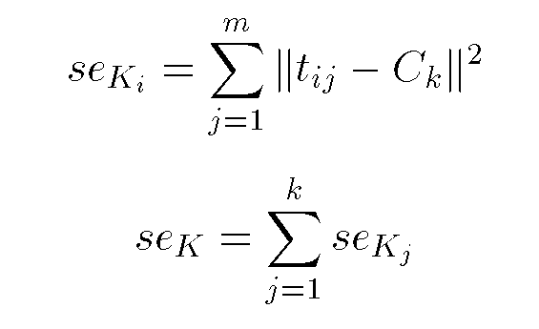
Squared Error
Slide based on one by Eamonn Keogh
10
9
8
7
6
5
4
3
2
1
1
2
3
4
5
6
7
8
9
10
Objective Function

Slide 38
Slide based on one by Eamonn Keogh
Partition Algorithm 1: k-means
1. Decide on a value for k.
2. Initialize the k cluster centers (randomly, if necessary).
3. Decide the class memberships of the N objects by assigning them to the nearest cluster center.
4. Re-estimate the k cluster centers, by assuming the memberships found above are correct.
5. If none of the N objects changed membership in the last iteration, exit. Otherwise goto 3.

Slide 39
K-means Clustering: Step 1
Algorithm: k-means, Distance Metric: Euclidean Distance
5
4
k₁
3
k₂
2
1
k₃
0
0
1
2
3
4
5
Slide based on one by Eamonn Keogh

Slide 40
K-means Clustering: Step 2
Algorithm: k-means, Distance Metric: Euclidean Distance
5
4
k₁
3
k₂
2
1
k₃
0
0
1
2
3
4
5
Slide based on one by Eamonn Keogh

Slide 41
K-means Clustering: Step 3
Algorithm: k-means, Distance Metric: Euclidean Distance
5
4
k₁
3
2
k₃
k₂
1
0
0
1
2
3
4
5
Slide based on one by Eamonn Keogh

Slide 42
K-means Clustering: Step 4
Algorithm: k-means, Distance Metric: Euclidean Distance
5
4
k₁
3
2
k₃
k₂
1
0
0
1
2
3
4
5
Slide based on one by Eamonn Keogh

Slide 43
K-means Clustering: Step 5
Algorithm: k-means, Distance Metric: Euclidean Distance
k₁
k₂
k₃
Slide based on one by Eamonn Keogh

Slide 44
Comments on k-Means
Strengths
Relatively efficient: O(tkn), where n is # objects, k is # clusters, and t is # iterations. Normally, k, t << n.
Often terminates at a local optimum.
Weakness
Applicable only when mean is defined, then what about categorical data?
Need to specify k, the number of clusters, in advance
Unable to handle noisy data and outliers
Not suitable to discover clusters with non-convex shapes
Slide based on one by Eamonn Keogh

Slide 45
How do we measure similarity?
Peter
Piotr
0.23
3
342.7
Slide based on one by Eamonn Keogh

Slide 46
A generic technique for measuring similarity
To measure the similarity between two objects, transform one into the other, and measure how much effort it took. The measure of effort becomes the distance measure.
The distance between Patty and Selma:
Change dress color, 1 point
Change earring shape, 1 point
Change hair part, 1 point
D(Patty,Selma) = 3
The distance between Marge and Selma:
Change dress color, 1 point
Add earrings, 1 point
Decrease height, 1 point
Take up smoking, 1 point
Lose weight, 1 point
D(Marge,Selma) = 5
This is called the “edit distance” or the “transformation distance”
Slide based on one by Eamonn Keogh

Slide 47
Edit Distance Example
How similar are the names “Peter” and “Piotr”?
Assume the following cost function Substitution 1 Unit
Insertion 1 Unit
Deletion 1 Unit
D(Peter,Piotr) is 3
It is possible to transform any string Q into string C, using only Substitution, Insertion and Deletion.
Assume that each of these operators has a cost associated with it.
The similarity between two strings can be defined as the cost of the cheapest transformation from Q to C.
Note that for now we have ignored the issue of how we can find this cheapest transformation
Peter
Piter
Pioter
Piotr
Substitution (i for e)
Insertion (o)
Piotr
Pyotr
Pedro
Piero
Peter
Petros
Pietro
Pierre
Deletion (e)
Slide based on one by Eamonn Keogh

Slide 48
Questions to ask about any clustering algorithm:
What distance metric is used?
What assumptions are made about the data?
Notes:
Assuming all features are important
normalized

Slide 49
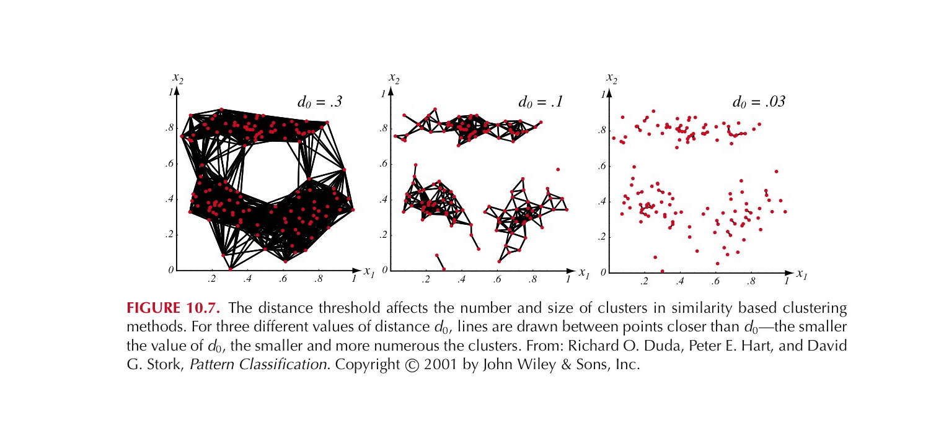
Partition Algorithm 2: Using a Euclidean Distance Threshold to Define Clusters
Notes:
If we say that two examples belong to the same cluster if the Euclidean distance bwtween them is less than some distance d_o. It is immediately obvious that the choice of d_o is
critical. If d_o is large all of the samples will be assigned to one cluster, if d_o is very small each sample will form an isolated singleton cluster. To obtain natural clusters, d_o will have to be greater than the typical within cluster distances and less than the typical between cluster distances.

Slide 50
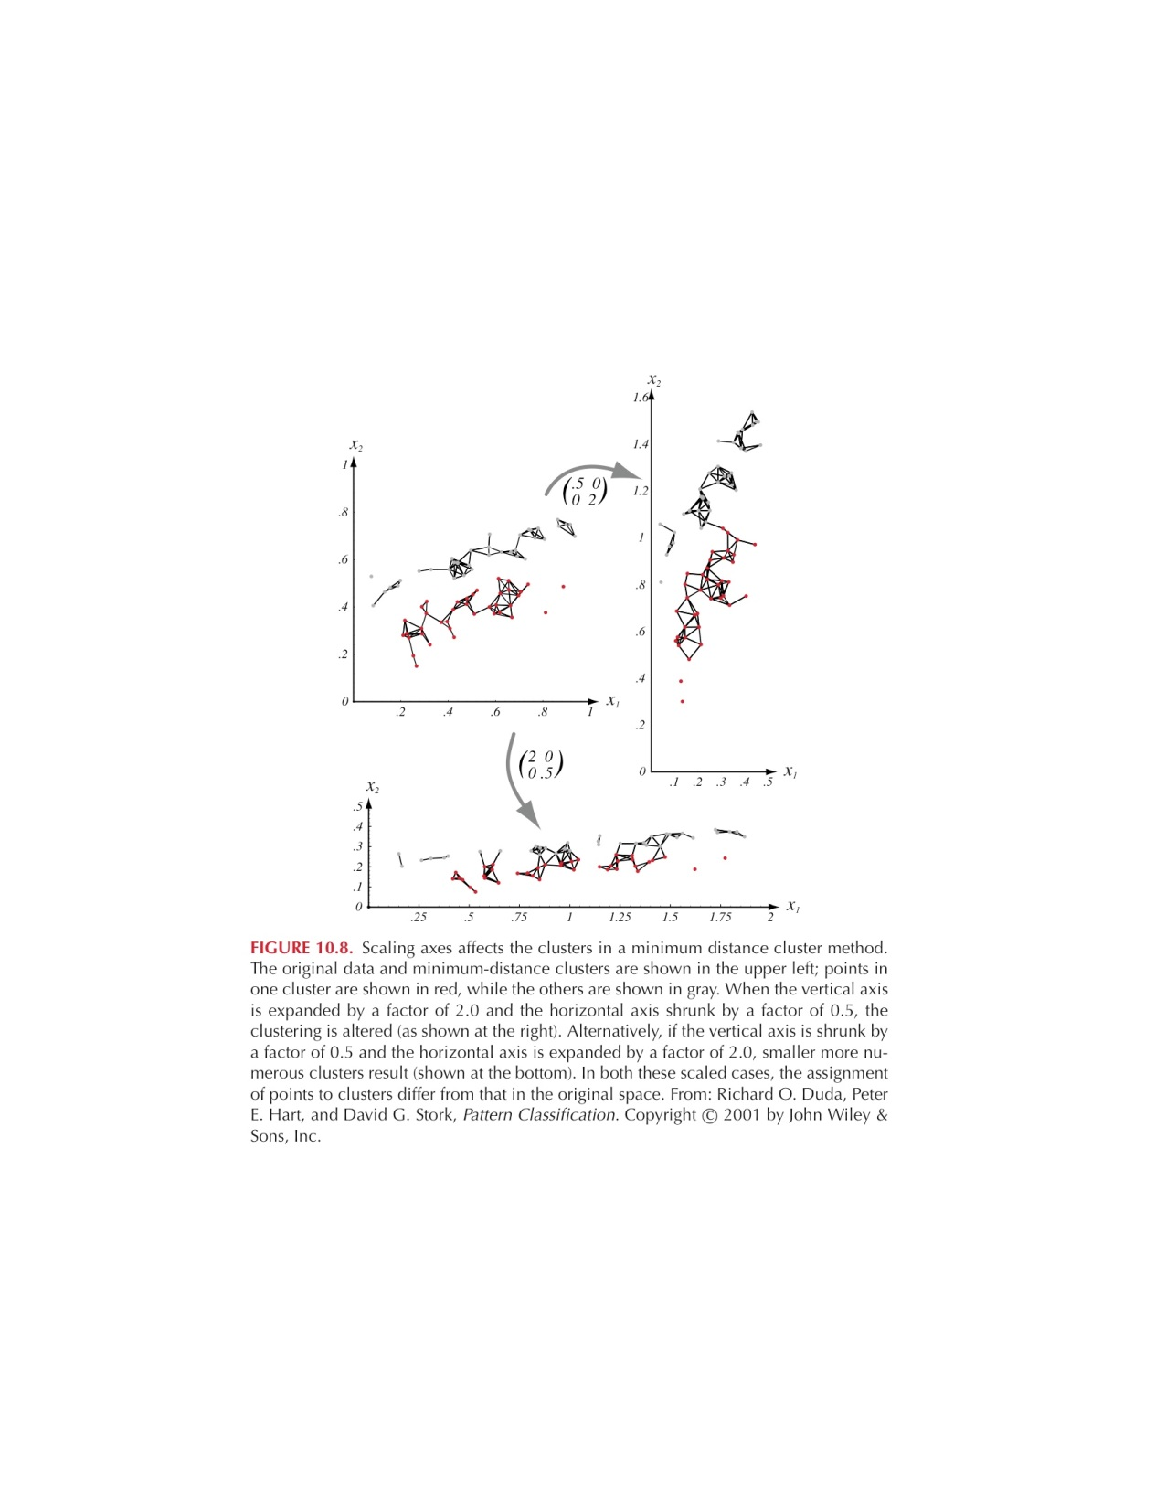
But should we use Euclidean Distance?
Good if data is isotropic and spread evenly along all directions
Not invariant to linear transformations, or any transformation
that distorts distance relationships
Notes:
Isotropic means uniform in all directions
Figure shows that simple scaling of the coordinate axes can result in a different grouping of the data into clusters.
One way to achieve invariance is to normalize the data before clustering!!!

Slide 51
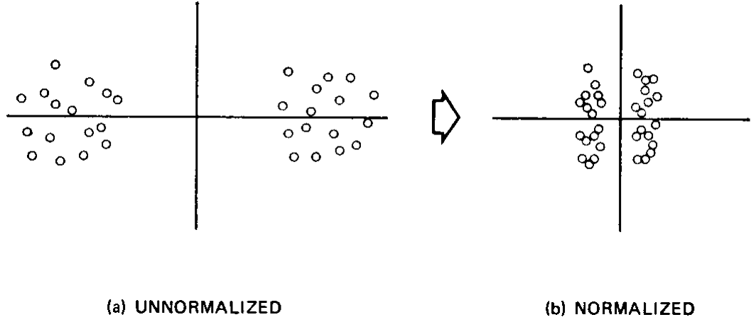
Is normalization desirable?

Slide 52
Other distance/similarity measures
Distance between two instances x and x’, where q >= 1 is a selectable parameter and d is the number of attributes (called the Minkowski Metric)
Cosine of the angle between two vectors (instances) gives
a similarity function:
Notes:
Q = 1 we have the manhattan distance, if q = 2 we have the euclidean distance….

Slide 53
Other distance/similarity measures
Distance between two instances x and x’, where q >= 1 is a selectable parameter and d is the number of attributes (called the Minkowski Metric)
When features are binary
this becomes the number of attributes shared by x and x’ divided by the geometric mean of the number of attributes in x and the number in x’. A simplification of this is:
Cosine of the angle between two vectors (instances) gives
a similarity function:
Notes:
Q = 1 we have the manhattan distance, if q = 2 we have the euclidean distance….

Slide 54
What is a good clustering?

Slide 55
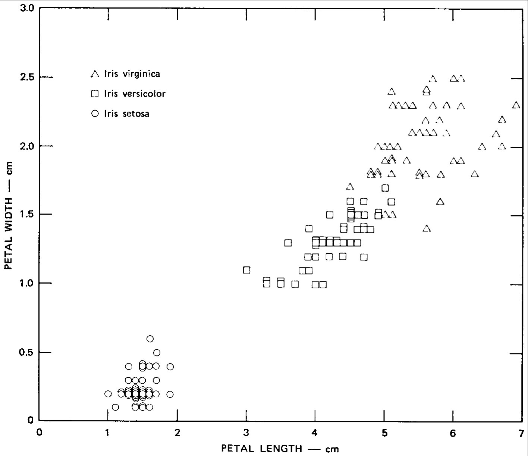
Clustering Criteria: Sum of Squared Error
Notes:
The value of J depends on how well the data are grouped into clusters
and an optimal partitioning is defined to be one that minimizes J
interpretation of criterion: for a given cluster $w_m$, the
mean vector is the best representative of the samples in $w_m$
in the sense that it minimizes the sum of the squared lengths of the ``error
vectors''. Thus J represents the total squared error incurred in representing the n samples by the $k$ cluster centers $w_1,...,w_k$
This is a prototype view of clustering
This is a good example. This shows two of the four
measurements of 150 examples of three species of Iris flowers
(The iris data at UCI)

Slide 56
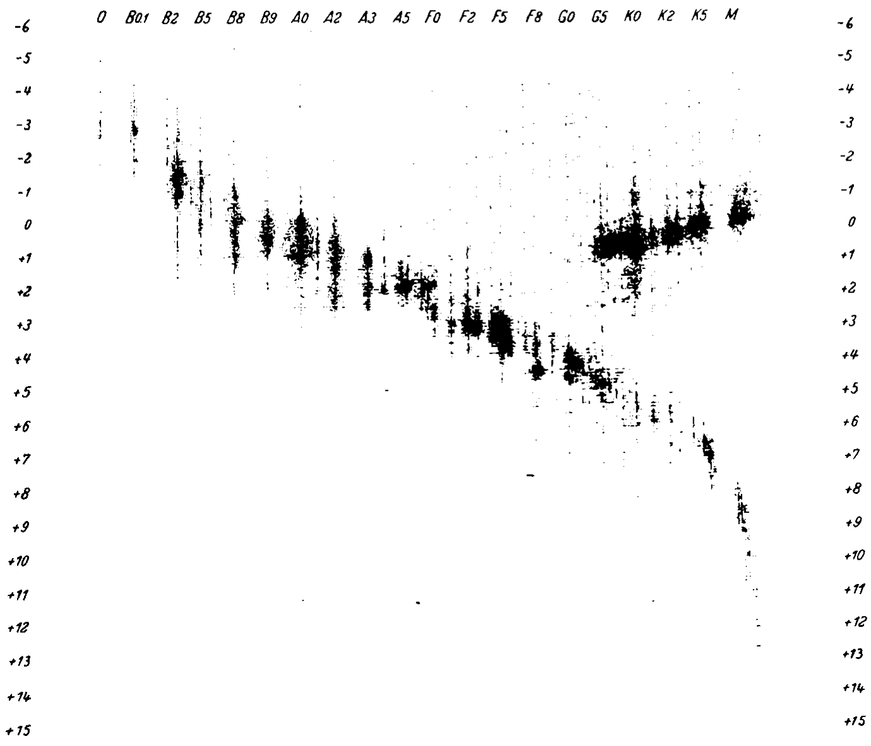
A Dataset for which SSE is not a good criterion.
Notes:
Hertzsprung and Russell diagram (often used to show the limitations
of simple clustering algorithms.
\item If $k$ = 2, this would not find the two clusters but would find two
circles

Slide 57
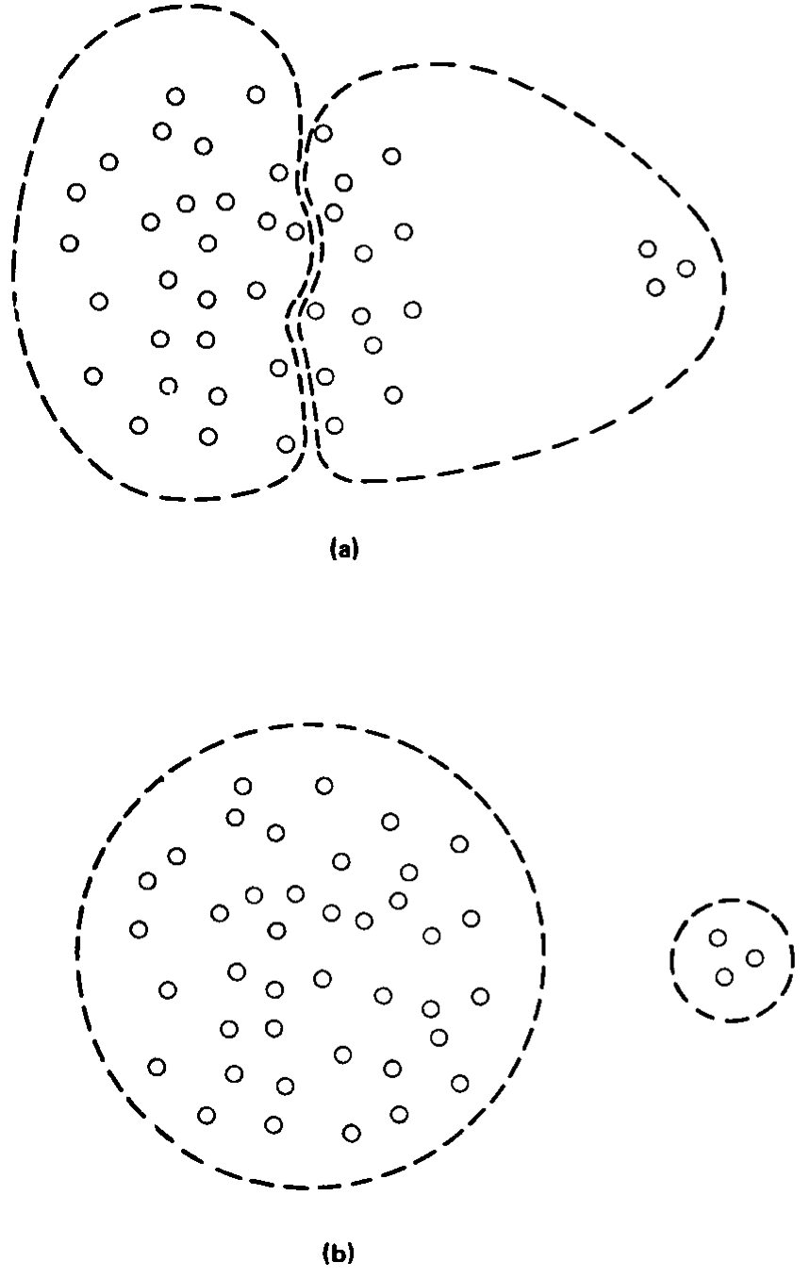
How does cluster size impact performance?
Notes:
\item the sum of the squared error for a is smaller than for b
\item If there are large differences in the numbers of samples in different clusters
then it may happen that a partition that splits a large cluster is favored
over one that maintains the integrity of the clusters merely because the
slight reduction in squared error achieved is multiplied by many terms in the
sum
\item what about outliers?
\item Although in this example the difference is probably small
\item previous example is perhaps better -- given $k$ = 2,
this would not find the two clusters but would find two circles

Slide 58
To apply partitional clustering we need to:
Select features to characterize the data
Collect representative data
Choose a clustering algorithm
Specify the number of clusters

Slide 59
Choosing the number of clusters (k)
Idea 1: Cross-validation
Idea 2: Subjective opinions of domain experts
Idea 3: “Take a knee” in the Scree plots
(If you plot solution quality against k, when does the slope suddenly change from steep to flat?)

Slide 60
When k = 1, the objective function is 873.0
1
2
3
4
5
6
7
8
9
10
Slide based on one by Eamonn Keogh

Slide 61
When k = 2, the objective function is 173.1
1
2
3
4
5
6
7
8
9
10
Slide based on one by Eamonn Keogh

Slide 62
When k = 3, the objective function is 133.6
1
2
3
4
5
6
7
8
9
10
Slide based on one by Eamonn Keogh

Slide 63
We can plot the objective function values for k equals 1 to 6…
The abrupt change at k = 2, is highly suggestive of two clusters in the data. This technique for determining the number of clusters is known as “knee finding” or “elbow finding”.
1.00E+03
9.00E+02
8.00E+02
7.00E+02
6.00E+02
Objective Function
5.00E+02
4.00E+02
3.00E+02
2.00E+02
1.00E+02
0.00E+00
k
1
2
3
4
5
6
Slide based on one by Eamonn Keogh

Slide 64
High-Dimensional Data poses Problems for Clustering
Difficult to find true clusters
Irrelevant and redundant features
All points are equally close
Solutions: Dimensionality Reduction
Feature subset selection
Cluster ensembles using random projection

Slide 65
Redundant
x
y
x
x
x
x
x
x
x
x
x
x
x
x
x
x
x
x
x
x
x
x
x
x
x
x
x
x
x
x
x
x
x
x
x
x
x
x
x
x
x
x
x
x
x
x
x
x
x
x
x
x
x
x
x
x
x
x
x
x
x
x
x
y
xxxxxxxxxx
xxxxxxxx
x
Notes:
This is an example of redundant features. Feature y provides the same cluster/grouping information as feature x.

Slide 66
Irrelevant
y
x
x
x
x
x
x
x
x
x
x
x
x
x
x
x
x
x
x
x
x
x
x
x
x
x
x
x
x
x
x
x
x
x
x
x
x
x
x
x
x
x
x
x
x
x
x
x
x
x
x
x
x
x
x
x
x
y
xxxxxxxxxx
xxxxxxxx
x
Notes:
This is how data looks like in feature x. This is the data in feature y. Feature y does not contribute to cluster discrimination. It does not provide us any interesting structure. We thus consider feature y here as irrelevant.
Note that irrelevant features can misguide clustering results (especially when there are more irrelevant features than relevant ones).

Slide 67
Curse of Dimensionality
100 observations cover the 1-D unit interval [0,1] well
Consider the 10-D unit hypersquare, 100 observations are now isolated points in a vast empty space.
Notes:
The curse of D was coined by Richard Bellman in 1961 applied to the problem caused by the rapid increase in volume associated with adding extra dimensions to a space. Its an obstabcle because the local neighborhood in higher dimensions is no longer local -- the sparsity increases exponentially given a fixed amount of data points

Slide 68
Consequence of the Curse
Suppose the number of samples given to us in the total sample space is fixed
Let the dimension increase
Then the distance of the k nearest neighbors of any point increases

Slide 69
Feature Selection Methods
Filter (Traditional approach)
Apply wrapper approach (Dy and Brodley, 2004)
Filter
Selected
Features
All Features
Clustering
Algorithm
Clusters
Selected
Features
Feature
Subset
Clustering
Algorithm
Clusters
Feature
Evaluation
Criterion
Clusters
All Features
Search
Selected
Features
Criterion Value
Notes:
The wrapper approach incorporates the clustering algorithm in the feature search and selection.
In the wrapper approach we apply a search method to search the feature subset space. Then we cluster each feature subset candidate. Then, we evaluate the clusters found in this subspace. And repeat the process until we find the best feature subset with its corresponding clusters based on our feature evaluation criterion.
The idea of a wrapper approach to feature selection comes from work in feature selection in supervised learning. The idea of customizing the feature subset to not
Just the data but to the machine learning algorithm was first developed by John and Kohavi.
Our contribution was in realizing that it could be applied to feature selection for unsupervised learning, given that you could define a good criterion function for evaluating your clusters.

Slide 70
Feature
Subset
Clustering
Algorithm
Clusters
Feature
Evaluation
Criterion
Clusters
All Features
Search
Selected
Features
Criterion Value
Notes:
We explore the wrapper framework using our algorithm called FSSEM (Feature Subset Selection using EM clustering). Our input is the set of all features. And the output is the selected features and the clusters found in this feature subspace.
We now go through each of the three choices.

Slide 71
Feature
Subset
Clustering
Algorithm
Clusters
Feature
Evaluation
Criterion
Clusters
All Features
Search
Selected
Features
Criterion Value
Notes:
The first component is our method for searching through candidate feature subsets.
The ideal search would be an exhaustive search, but this would require that we evaluate
2 to the d candidate subsets…which is computationally intractable. Therefore we need to use some sort of greedy method.

Slide 72
Feature
Subset
Clustering
Algorithm
Clusters
Feature
Evaluation
Criterion
Clusters
All Features
Search
Selected
Features
Criterion Value
FSSEM Search Method: sequential forward search
A
B
C
D
A, B
B, C
B, D
A, B, C
B, C, D
Notes:
We applied sequential forward search in our experiments. For other applications, we have applied other search methods – we have also developed an interactive framework for visually exploring clusters – appeared in KDD 2000
This is a greedy method that may find a suboptimal solution. Take the case where 2
Features alone tell you nothing – but together they tell you a lot.

Slide 73
Feature
Subset
Clustering
Algorithm
Clusters
Feature
Evaluation
Criterion
Clusters
All Features
Search
Selected
Features
Criterion Value
Notes:
The next choice we need to make is our clustering algorithm

Slide 74
Feature
Subset
Clustering
Algorithm
Clusters
Feature
Evaluation
Criterion
Clusters
All Features
Search
Selected
Features
Criterion Value
Clustering Algorithm:
Expectation Maximization
Notes:
To perform our clustering, we chose EM or EM-k clustering as our clustering algorithm. Other clustering methods can also be used in this framework. EM clustering is the maximum likelihood estimate of a finite Gaussian mixture model. Recall that to cluster data, we need to make assumptions and define what “natural” grouping means. Note that with this model, we assume that each of our “natural” groups are Gaussian. We call this EM clustering because the expectation-maximization algorithm by Dempster, Laird and Rubin is used to optimize and approximate our maximum likelihood estimate.
EM-k is EM clustering with order identification or finding the number of clusters. To find the number of clusters, we used a well-known penalty method. In particular, we applied a minimun description length (MDL) penalty term to the maximum likelihood criterion. A penalty term is needed in the search for k (the number of clusters), because ML increases as k is increased. And, we do not want to end up with the trivial result wherein each data point is considered as a cluster.

Slide 75
Searching for the Number of Clusters
Using a fixed number of clusters for all feature sets does not model the data in the respective subspace correctly.
F
x
3
x
x
x
x
x
x
x
x
x
x
x
x
x
x
x
x
x
x
x
x
x
x
x
x
x
x
x
x
x
x
x
x
x
x
x
x
x
x
x
x
x
x
x
x
x
x
xxxxxxxxxx
xxxxxxxx
F
2
Notes:
(read text)
Now, we consider the bias of our feature selection criteria with dimension. There is no problem when we compare feature
subsets with the same dimension. The problem occurs when we compare feature subsets with different dimensions.

Slide 76
Feature
Subset
Clustering
Algorithm
Clusters
Feature
Evaluation
Criterion
Clusters
All Features
Search
Selected
Features
Criterion Value
Notes:
The final choice is how we will evaluate the results of applying clustering to the candidate feature subset. This information is fed back to the search algorithm to guide its search.

Slide 77
Generalization of k-means clustering
More general models (e.g., mixtures of Gaussians) can be used, instead of rigid symmetric (e.g. circular) clusters that don’t overlap.
Expectation-Maximization (EM) algorithm iterates over two steps (E & M), similar to k-means clustering which iterates over 2 steps (assigning points to clusters, and computing centroid).

Slide 78
EM with Gaussian Mixture Models
The model consists of k Gaussian distributions (resembling k-means clustering).
The parameters of the model consist of:
”Centroids” of the Gaussians
Covariance matrices of the Gaussians
Relative weights (“mixing coefficients”) of Gaussians
(k-means clustering is a special case, where each weight is 0 or 1)
Goal: Learn the best parameter values, maximizing the expectation that the given data is generated by the model.
For each data point, the probability of generation by the model = 𝛴 _{k} (probability of being generated by k^{th} Gaussian)

Slide 79
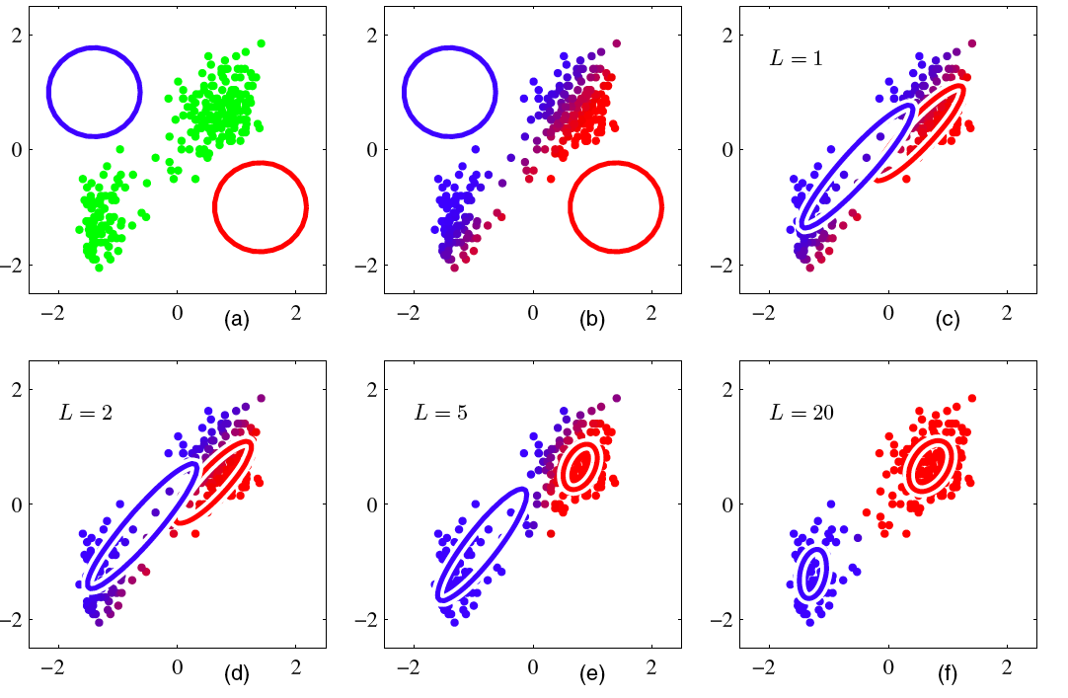
Visualization of EM iterations (with a mixture of 2 Gaussians)

Slide 80
“Responsibilities”
In each iteration, each cluster is associated with some current parameter values.
“Responsibility”: probability that a data point d_{j} is generated by the i^{th} distribution with the current parameters.
Responsibilities are re-evaluated in every iteration of the EM algorithm; in addition to the centroid, the covariance matrix is also important, allowing for asymmetric clusters.
Special case of k-means clustering: In each iteration, each data point is uniquely assigned to one cluster. Only one cluster is responsible for any point, with value 1, all others are 0s. A data point previously assigned to cluster 3 may be assigned in the next iteration to cluster 5.

Slide 81
Why the covariance matrices?
Euclidean distance provides equal weightage to all dimensions, e.g., even if you measure your height in light years and weight in grams.
The available data (for the problem of interest) tells us about the appropriate coefficients to be used in combining light years and grams!
This information is represented in the Covariance Matrix associated with the data.
“Mahalanobis Distance” uses this matrix.

Slide 82
Mahalanobis distance
Distance of a point x from a distribution with mean m and covariance matrix S: sqrt( (x-m)^{T} S⁻¹ (x-m))
Distance between points x and y from the same distribution with covar. matrix S: sqrt( (x-y)^{T} S⁻¹ (x-y))
Distance between points x and y from the same distrib. with a diagonal cov. matrix whose i^{th} entry is s_{i}: sqrt( 𝛴(x_{i} -y_{i})² / s_{i}² ), a standardized Euclidean distance.

Slide 83
Softmax
Given a bunch of non-negative values, we can convert them into numbers that look like probabilities: divide each by the sum.

Slide 84
Expectation Maximization with Gaussian Mixture Models
At each iteration, we have a current description of a bunch of Gaussians (centroids, covariance matrices, weights)
Within each iteration:
Each point is “softly assigned” to various Gaussians, finding responsibility values by using the softmax of the squared Mahalanobis distance from each point to each Gaussian.
Each centroid is adjusted, using the weighted means of the data, with weights given by responsibilities that were just calculated.

Slide 85
EM with GMMs: slightly more formal description
Initialize k centroids, covariances, and weights;
While (model values are unsatisfactory and/or continue to change significantly), do:
Evaluate responsibilities r for each point and each Gaussian;
Update centroids µ using r.
Update covariance matrices using µ and r.
Update weights to be the softmaxed sums of responsibilities.
Evaluate model using:
log( prob (data | model parameter values))

Slide 86
k-Means vs. EM
k-Means is fast and has no parameters!
EM is better if clusters can be asymmetric, and/or different dimensions vary substantially for each other.
In both, we need to determine k, e.g., using the elbow method, or starting with some k and steadily increasing/decreasing k until we are satisfied.

Slide 87
Another clustering approach: Affinity Propagation
Non-numerical data—we may have some other similarity measure.
The number of clusters (k) is not given.
Based on similarity, we determine the most similar other data point (“prototype”) for each data point.
If two data points have the same prototype, they are considered to be in the same cluster.
The existence of distant points does not affect the results, since no centroid is computed!

Slide 88
Affinity Propagation Algorithm
Initialization (to zeroes) and computation of similarities between all pairs of data points;
While (…) do:
Update “responsibility” values that convey how well one datum is suited to be the prototype for another;
Update “availability” values to determine the converse, depending on other points’ responsibility values.
Return (as prototypes) those data for which responsibility + availability > 0.

Slide 89
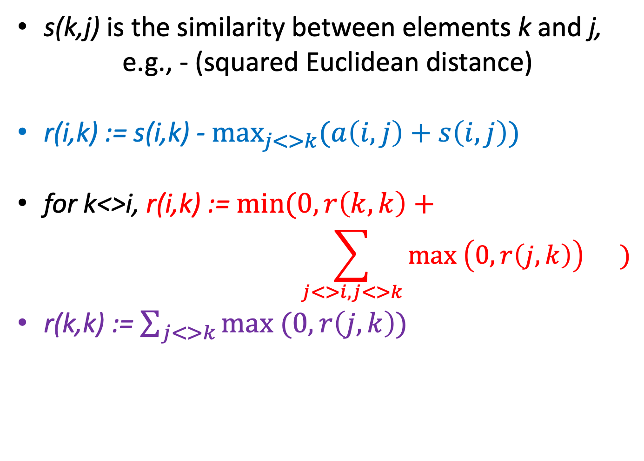
Affinity Propagation: Update Equations
s(k,j) is the similarity between elements k and j,
e.g., - (squared Euclidean distance)
r(i,k) := s(i,k) - $\max_{j<>k}{(a\left(i,j\right)+s\left(i,j\right))}$
for k<>i, r(i,k) := $min⁡(0, r\left(k,k\right)+$
$$\sum_{j<>i, j<>k}{\max\left(0, r\left(j,k\right)\right) )}$$
r(k,k) := $\sum_{j<>k}{\max{(0, r\left(j,k\right))}}$

Slide 90
Affinity Propagation: Termination
Stop when there is no more change to cluster membership, or after reaching an upper bound on the number of iterations.
The final prototypes (”exemplars”) are those for which r(k,k)+a(k,k)>0.

Slide 91
Summary of Clustering Algorithms
Choice of similarity or distance metric is important.
Some applications require asymmetric, overlapping, or non-exhaustive clusters.
The number of clusters may have to be determined by us, based on experimentation (e.g., elbow in Scree plot) & upper/lower bounds appropriate for the problem.
A few important kinds of clustering algorithms:
Hierarchical (top-down or bottom-up)
K-means
Expectation Maximization with Gaussian Mixture Models
Affinity Propagation
Computational effort required differs for these.

